Slide 1
Python

Slide 2
Repetition Strings
String is data type that stores a sequence of characters.
    Basic Operations
        Concatenation (Joining Strings) “Hello” + “world”
        (Repeat a string multiple times)
        Length of a string
        Indexing (Access a character by position)
        Slicing (Extract a part of the string) and also work as negative
        Change Case
        Searching Substrings
        Strip (Remove spaces)
        Replace
        Split & Join
Notes:
a = "Hello"
b = "World"
result = a + " " + b
print(result) # Output: Hello World
______________________________
s = "Ha"
print(s * 3) # Output: HaHaHa
__________________________________
name = "Python"
print(len(name)) # Output: 6
__________________________________
word = "Hello"
print(word[0]) # Output: H
print(word[-1]) # Output: o (last character)
_______________________________
text = "Python Programming"
print(text[0:6]) # Output: Python
print(text[7:]) # Output: Programming
________________________________
name = "sahel"
print(name.upper()) # Output: SAHEL
print(name.capitalize()) # Output: Sahel
print(name.lower()) # Output: sahel
_____________________________________
sentence = "Learning Python is fun"
print("Python" in sentence) # True
print("Java" not in sentence) # True
___________________________________
data = " Hello "
print(data.strip()) # Output: Hello
__________________________________
text = "I love Java"
print(text.replace("Java", "Python")) # Output: I love Python
_______________________________________
words = "apple,banana,grape"
split_list = words.split(",") # ['apple', 'banana', 'grape']
joined = "-".join(split_list) # apple-banana-grape
____________________________________________
name = "Sahel"
age = 27
print(f"My name is {name} and I am {age} years old.")
# Output: My name is Sahel and I am 27 years old.

Slide 3
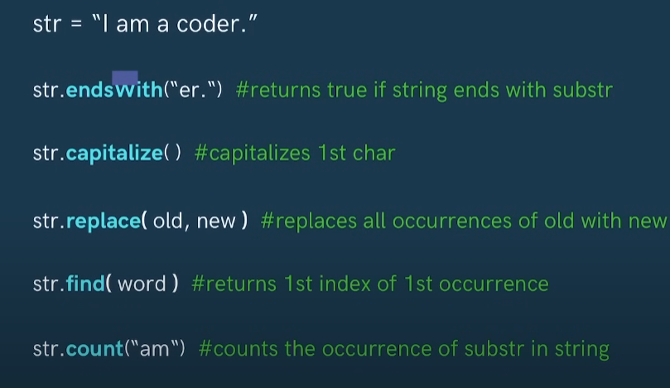
String Functions
Note : str is a built-in function not keyword it don’t give error now but we can’t use anymore str in program
Notes:
str = "hello"
print(str(123)) # TypeError: 'str' object is not callable
More ::
str = "i am a stUdant"
print(str.capitalize()) # I am a student
print(str.upper()) # I AM A STUDENT
print(str.lower()) # i am a student
print(str.title()) # I Am A Student
print(str.swapcase()) # I AM A STUDENT
print(str.find("m"))
print(str.endswith("n"))
print(str.startswith("i"))
print(str.count("a"))
print(str.replace("a","O"))

Slide 4
String Functions
Function | Description | Example
len() | Returns the length of the string | len("hello") → 5
lower() | Converts string to lowercase | "HELLO".lower() → "hello"
upper() | Converts string to uppercase | "hello".upper() → "HELLO"
capitalize() | Capitalizes first letter | "python".capitalize() → "Python"
title() | Capitalizes first letter of every word | "my name is ali".title() → "My Name Is Ali"
strip() | Removes whitespace from both ends | " hello ".strip() → "hello"
lstrip() | Removes left-side whitespace | " hello".lstrip() → "hello"
rstrip() | Removes right-side whitespace | "hello ".rstrip() → "hello"
replace(old, new) | Replaces substring | "Hello World".replace("World", "Python") → "Hello Python"
find(sub) | Finds first index of sub, returns -1 if not found | "hello".find("l") → 2
count(sub) | Counts how many times sub appears | "banana".count("a") → 3
startswith(sub) | Checks if string starts with sub | "hello".startswith("he") → True
endswith(sub) | Checks if string ends with sub | "world".endswith("ld") → True
split(sep) | Splits string into list | "a,b,c".split(",") → ['a', 'b', 'c']
join(list) | Joins list into string | " ".join(['Hello', 'World']) → "Hello World"
isalnum() | Checks if string is alphanumeric | "abc123".isalnum() → True
isalpha() | Checks if only letters | "abc".isalpha() → True
isdigit() | Checks if only digits | "123".isdigit() → True

Slide 5
?

